Slide 1

Group 2(The PICARD)
Abdalrahman Afifi
Hunter Lavender
Travis Mueller
Zachary Wildasin

Slide 2
What is PICARD?
Platform for Intelligent Computer Algorithm Research and Development
PICARD’s capabilities are to set up a distributed system and conduct research
This includes the data set of the users choosing, and algorithms as well
The user will be able to specify how many systems that are running for the test
The user will be able to specify the hardware requirements as well
This includes hardware specifications for EACH node

Slide 3
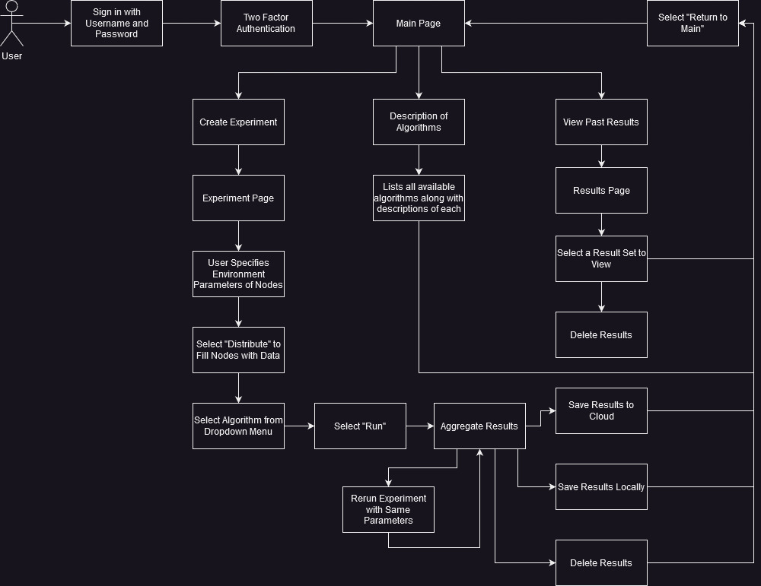
Front-End Diagram

Slide 4
FRONT-END Diagram
We created a graphical user interface to streamline the running of tests on our platform
Our main page acts as a landing page with three options
Create Experiment takes you to a screen that allows you to set the general parameters environment for the new experiment.
Description of Algorithms gives you the a list of all algorithms with their descriptions.
View past results shows you previous experiments.
Create Experiment is the option that gives us access to the actual functionality of the PICARD system and allows you to set up your own experiments.

Slide 5
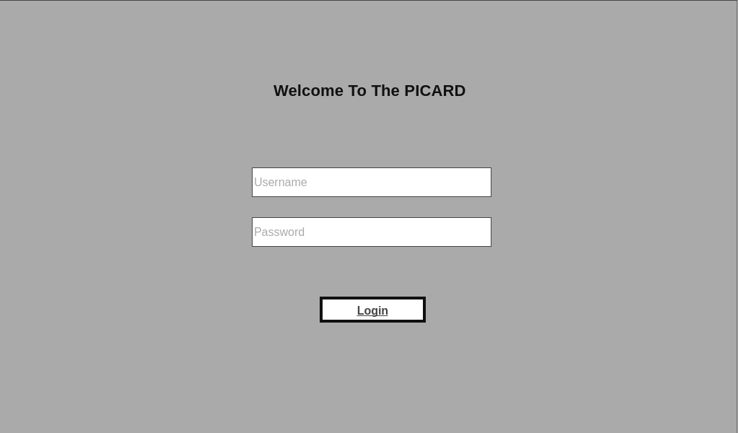
User Interface

Slide 6
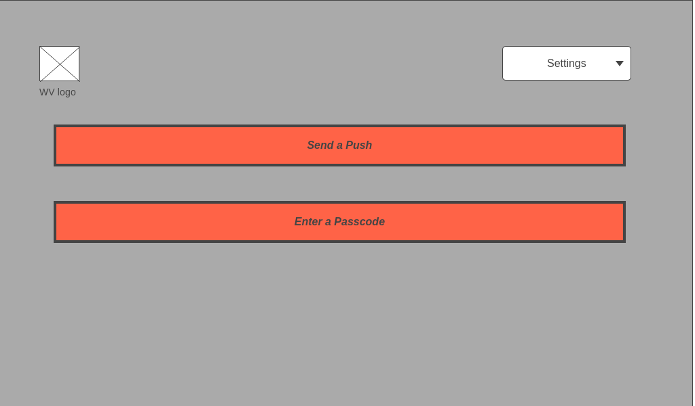
User Interface Cont.

Slide 7
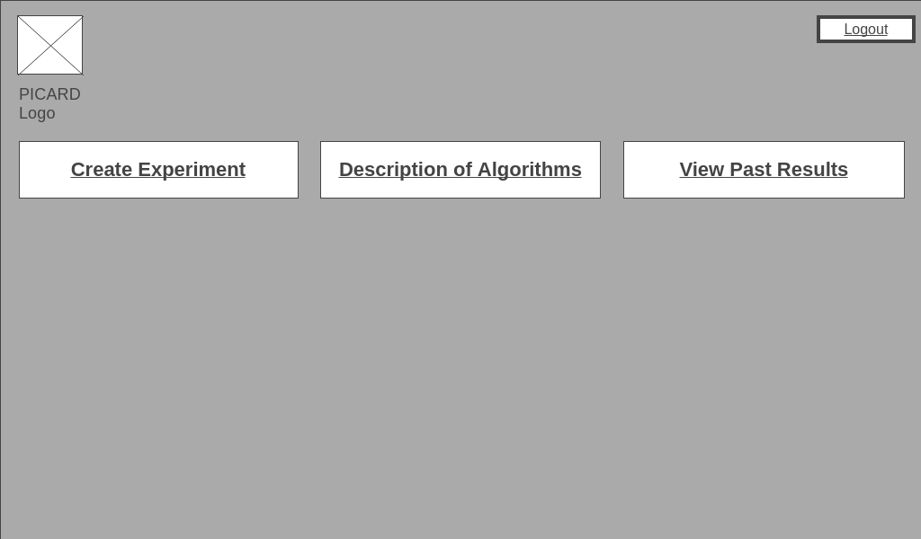
User Interface Cont.

Slide 8
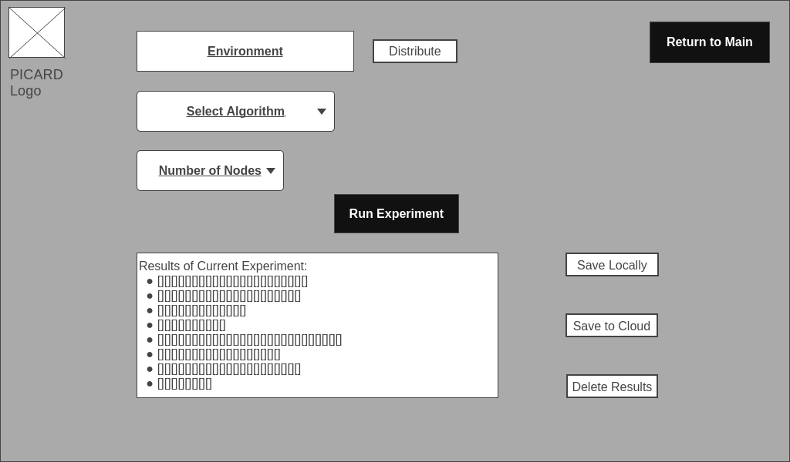
User Interface Cont.

Slide 9
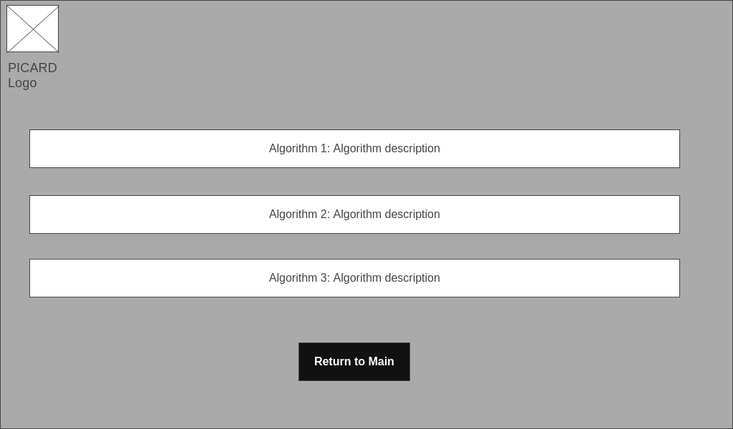
User Interface Cont.

Slide 10
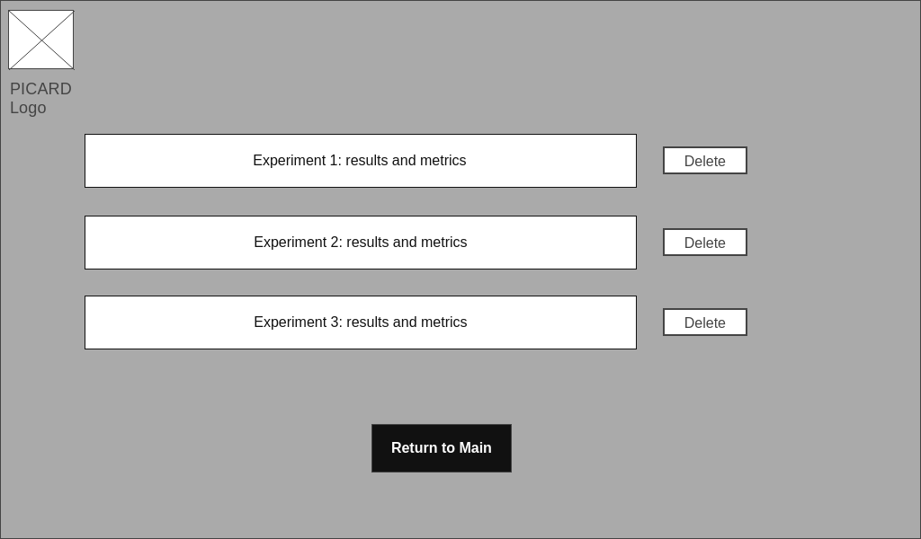
User Interface Cont.

Slide 11
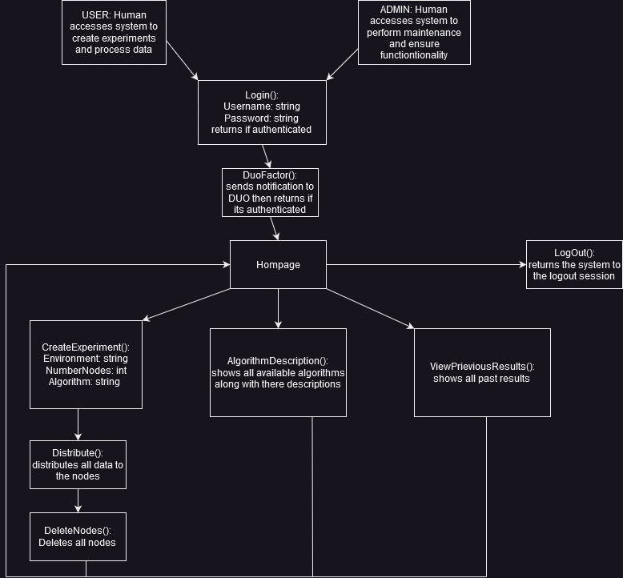
Deployment Diagram

Slide 12
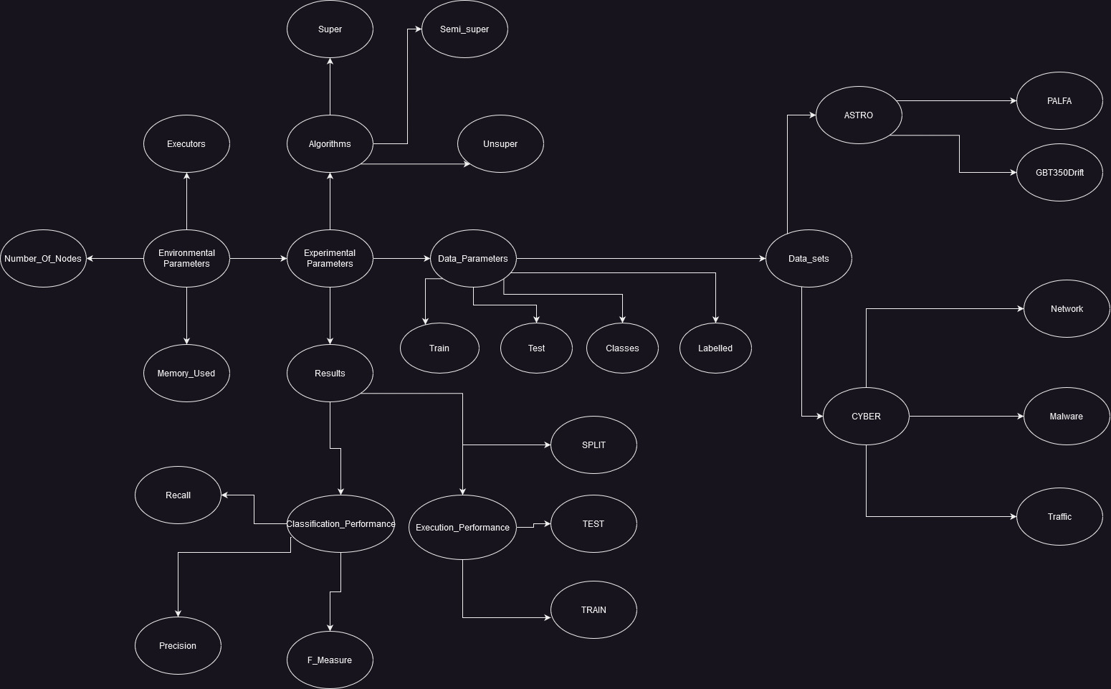
Entity Relationship Diagram

Slide 13
Entity Relationship Diagram
ER diagrams are used to model the structure of a database, showing the entities (things) and relationships between them.
Entities represent objects or concepts in the real world, such as customers, orders, or products.
Relationships show how entities are related to each other, such as a customer placing an order, or a product being part of an order.
ER diagrams use symbols to represent entities, attributes (properties of entities), and relationships. Common symbols include rectangles for entities, ovals for attributes, and diamonds for relationships.
Entities can have one or more attributes, which are characteristics that describe the entity. For example, a customer entity might have attributes like name, address, and phone number.

Slide 14
Relational Model Schema
RM diagrams are used to represent the structure of a relational database.
A relational database consists of one or more tables, each with a set of attributes (columns) that describe the data being stored.
Tables are connected by relationships, which define how data is related between tables.
The primary key of a table is a unique identifier for each record in the table, and is used to create relationships between tables.
Foreign keys are used to connect related tables, and are attributes in one table that refer to the primary key of another table.
RM diagrams use symbols to represent tables, attributes, and relationships. Common symbols include rectangles for tables, ovals for attributes, and lines with arrows for relationships.

Slide 15
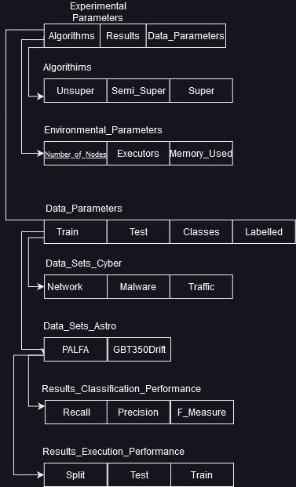
Relationship Model Schema

Slide 16
Any Questions?

Slide 17
Member Contribution table
Member Name | Meetings attended | Meetings missed | Contribution | Stuff done by member
Abdalrahman Afifi | 2 | 0 | 100 | ER Diagram, RM Schema slides,UI, editing
Hunter Lavender | 2 | 0 | 100 | ER Diagram, RM Schema slides,overview slide
Travis Mueller | 2 | 0 | 100 | Front end Diagram slides,UI, Deployment diagram
Zachary Wildasin | 1 | 0 | 100 | UI and editing

